Slide 1

Automatic Border Passage at Amsterdam Airport Schiphol
ACM ICPC, November 16th 2002
Art de Blaauw, manager projects

Slide 2
Overview
Automatic Border Passage explained
Co-operation with government and aviation interest groups
Automatic Border Passage architecture
Dartagnan

Slide 3
Overview
Automatic Border Passage explained
Co-operation with government and aviation interest groups
Architecture
Dartagnan

Slide 4
Privium
Privium: service/loyalty programme for frequent travellers
Integrated seamless travel programme
  priority, speed and comfort
  quick and secure border passage
  priority parking
  comfortable check-in
Priority treatment
  acknowledgement of frequent travellers

Slide 5
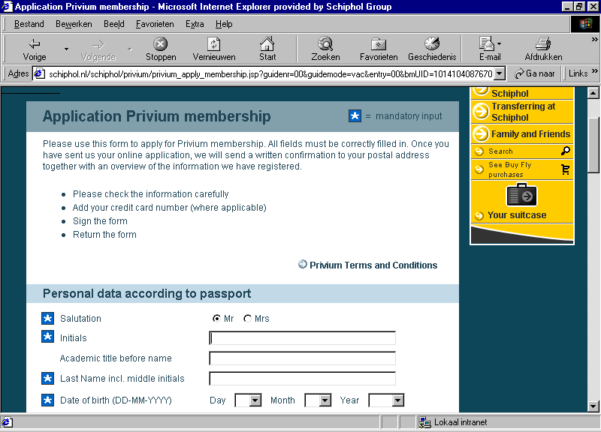

Slide 6
Automatic Border Passage Customer process
Enrollment process:
Card
personalization
Background
check
Biometric template
storage
Card issued
Authentication process:
Biometric
check
Card validation
Gate control
Background
check

Slide 7
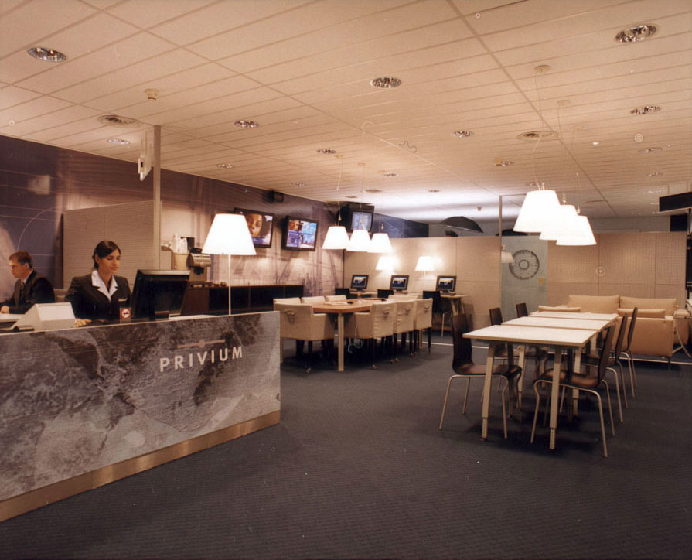
Automatic Border Passage (1)
Enrollment centre

Slide 8
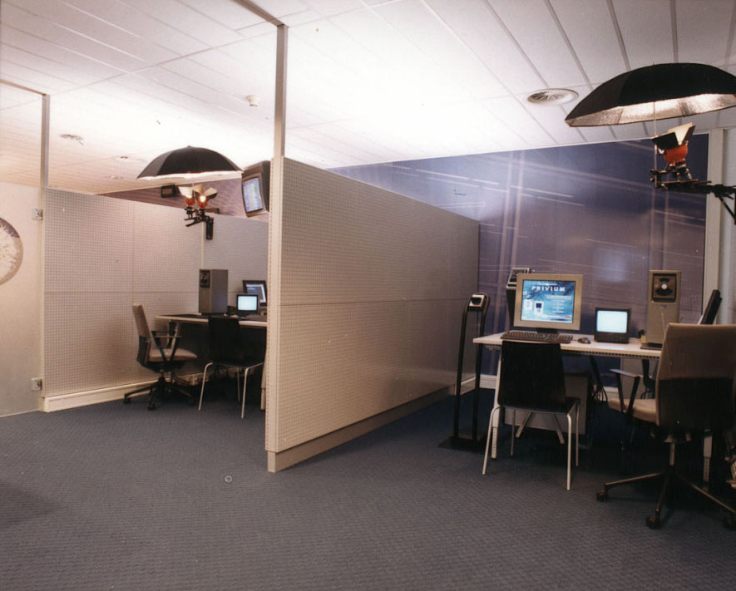
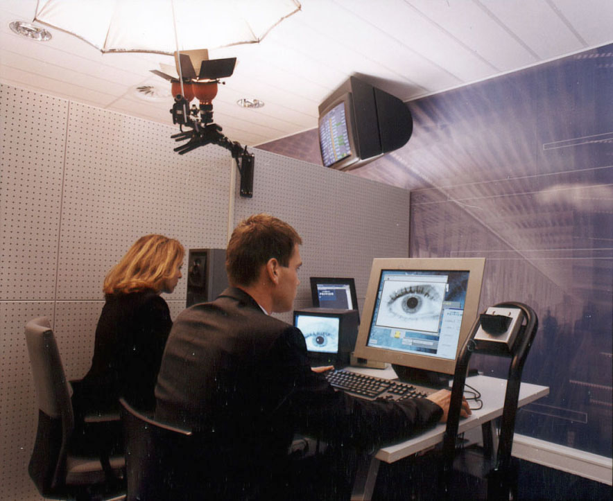
Automatic Border Passage (2)
Enrollment procedure

Slide 9

Automatic Border Passage (3)
Smart card

Slide 10
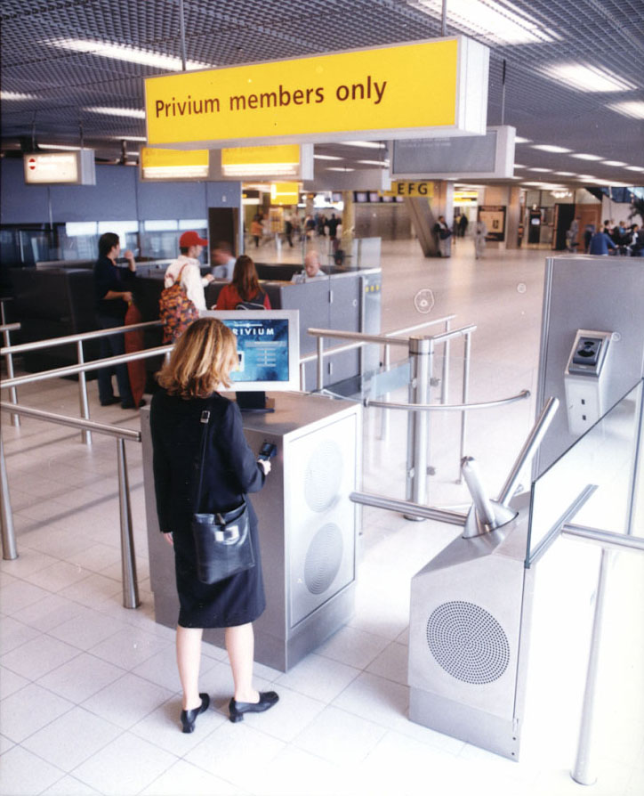
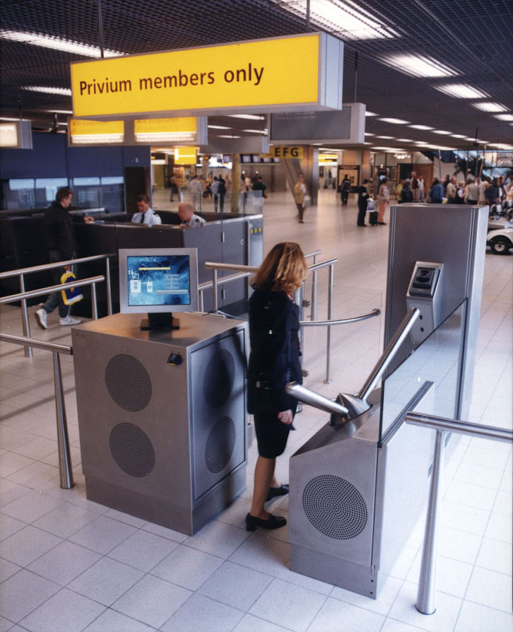
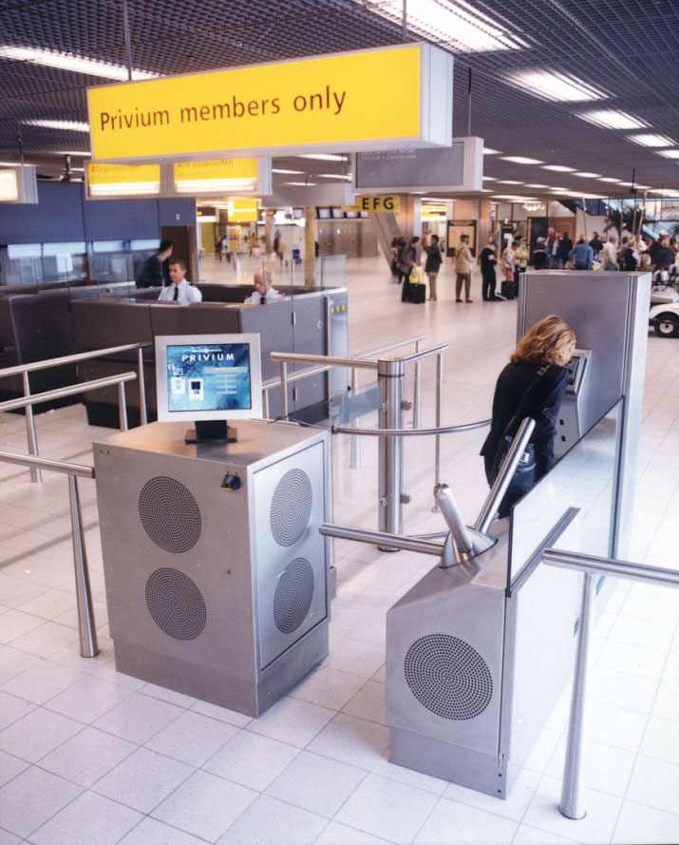
Automatic Border Passage (4)
Card validation

Slide 11
Overview
Automatic Border Passage explained
Co-operation with government and aviation interest groups
Architecture
Dartagnan

Slide 12
Co-operation with government and aviation interest groups (1)
Participating government agencies
  IND (Ministry of Justice)
  Border Police (Ministry of Defence)
Policy making agencies
  Dutch Registration Chamber (dealing with privacy issues)
  Home Office (New Generation Travel Documents)
  ICAO (TAG-NTWG) and IATA (SPT)

Slide 13
Co-operation with government and aviation interest groups (2)
Approval of Dutch Ministry of Justice
Compliance with European privacy regulations
Solution anticipates the use of New Generation Travel Documents in the Netherlands
Iris-recognition selected as one of the three biometric techniques recommended by ICAO-TAG-NTWG in 2002 (together with finger and face)
Privium card accepted as substitute for ticket/boarding pass

Slide 14
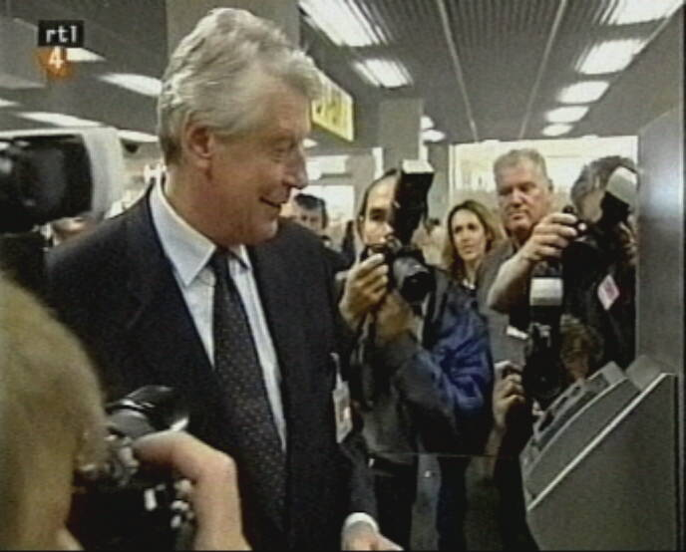
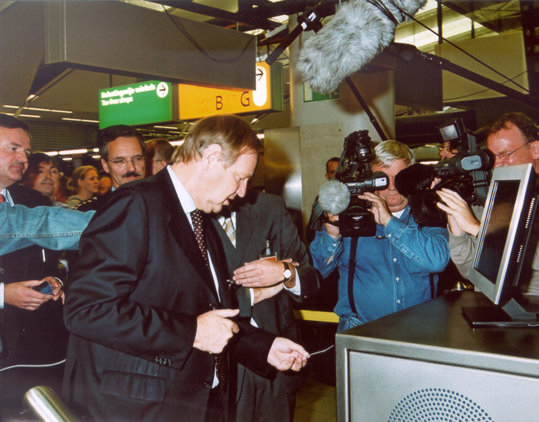
Co-operation with government and aviation interest groups (3)
Visit of former Dutch Prime Minister
Mr. W. Kok 02-10-2001
Opening by former Dutch Minister of Justice Mr. A.H. Korthals 23-10-2001

Slide 15
Overview
Automatic Border Passage explained
Co-operation with government and aviation interest groups
Architecture
Dartagnan

Slide 16
Process
Security versus convenience
Complete integration with existing aviation processes
End user oriented
Physical installation
Contact vs. Contactless chip
Card used once
Ergonomic turnstile
Verification zone
Pre-personalization of the card
Higher standards for enrollment

Slide 17
Technology (1)
Security vs privacy
Biometrics selection: iris
No biometric database, 1 to 1 comparison
Secured memory card
Separate data sets for each system
Systems separation (firewall)
Encrypted communication

Slide 18
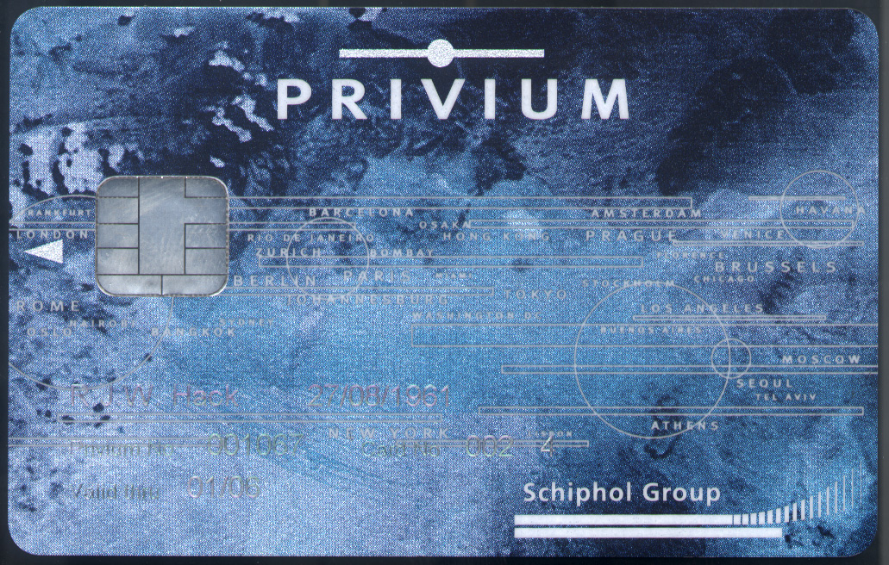
Technology (2)
Smartcard
Data card
  Iris scan data
  Membership
  NSIS data
3 separate partitions
Magnetic stripe (for parking facilities)
SAM (Security Authorization Module) cards used

Slide 19
Performance indicators
FAR, FRR, FTE
Throughput: 5 people per minute
Availability of the system: 99,5%
More secure than manual process
Trusted ← → Unknown passenger

Slide 20
Overview
Automatic Border Passage explained
Co-operation with government and aviation interest groups
Architecture
Dartagnan

Slide 21
Dartagnan™ biometric solutions
Dartagnan is a recently founded company that combines the complementary skills of its well-established parent companies Schiphol Group and Joh. Enschedé.
Dartagnan is a recently founded company that combines the complementary skills of its well-established parent companies Schiphol Group and Joh. Enschedé.
offers high-end identification and authentication solutions
aims to maximise integrity to the biometric identification process
creates the right balance between security, efficiency and convenience

Slide 22
Dartagnan’s parent companies
Schiphol Group
airport operator headquartered in The Netherlands, creates and develops AirportCities. Schiphol Group’s aim is to create a safe, reliable and sustainable airport operation, offering service levels equivalent to those of a major city.
Joh. Enschedé
300-year history in printing banknotes, passports, stamps and identification documents for governments and major corporations. The company’s core activity centres on providing security solutions for digital and printed products.
Partnership with IBM to market, sell, implement and service Border and Access Control solutions globally

Slide 23
Solutions
Border control
based on iris recognition, makes border passage more convenient, more efficient and more secure
Access control
using biometrics for high secure environments, where accurate identification is key issue
Transaction control
biometric identification to replace or enhance the transaction process for high value transactions
Attendance control
applying biometrics can reduce time-consuming manual processes and tighten security significantly

Slide 24
For more information please contact:
Art de Blaauw
Phone: +31(0)20 601 2619
Fax: +31(0)20 601 3804
E-mail: info@dartagnan-biometrics.com

